Slide 1
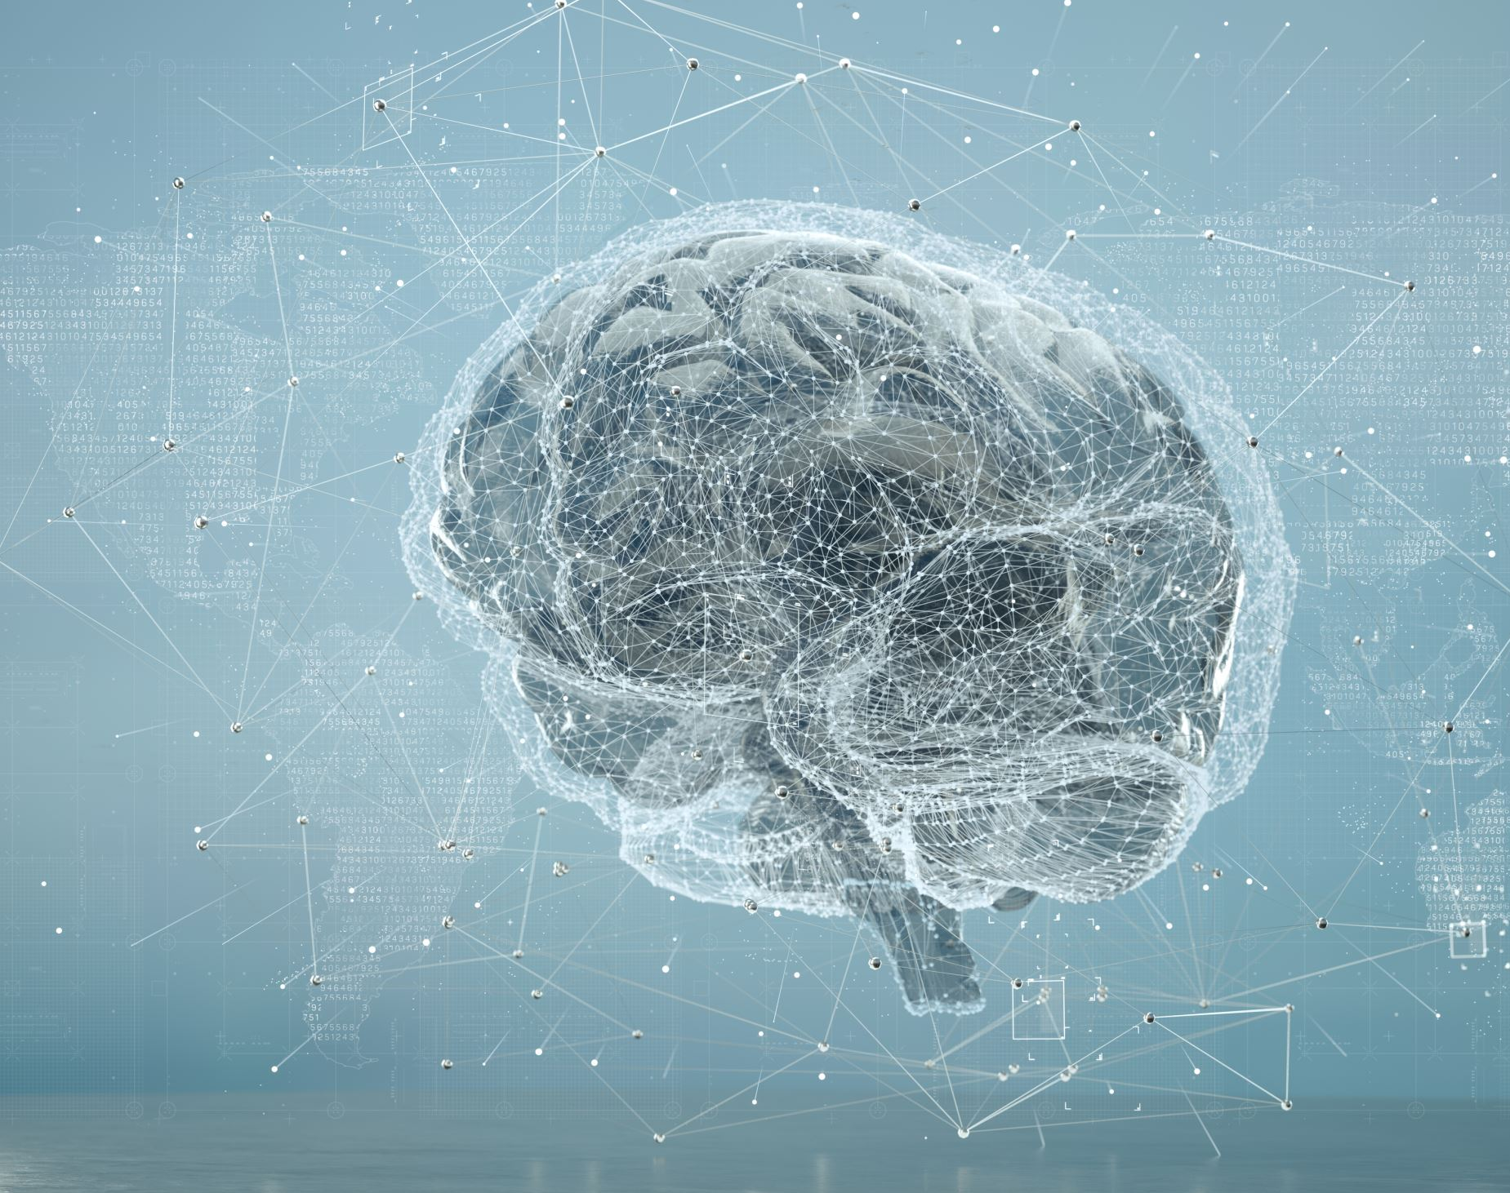
24CSA449_Artificial Intelligence
Lecture I: Introduction to AI

Slide 2
Overview
Introduction to AI
AI-History and evolution
Key concepts and definitions
Overview of Machine learning
Neural networks,
Natural language processing

Slide 3

Introduction to AI
What is AI?
  The power of a machine to copy intelligent human behavior.
  Study of how to make computers do things, which at the moment, people do better.
  Simulate human cognitive functions and exhibit autonomous behavior.

Slide 4
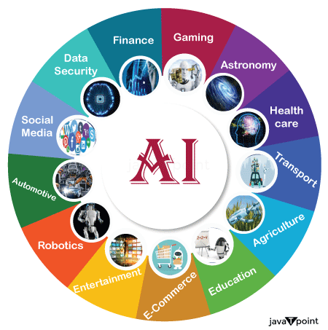
Introduction...
  Artificial Intelligence (AI) is a branch of computer science that focuses on creating systems capable of performing tasks that typically require human intelligence.
  These tasks include learning, reasoning, problem-solving, perception, understanding natural language, and decision-making.
  AI aims to develop machines that can simulate human cognitive functions (Human cognitive functions refer to the mental processes by which humans acquire knowledge and understanding like perception, attention, memory, learning, problem solving, decision making etc) and exhibit autonomous behavior.

Slide 5
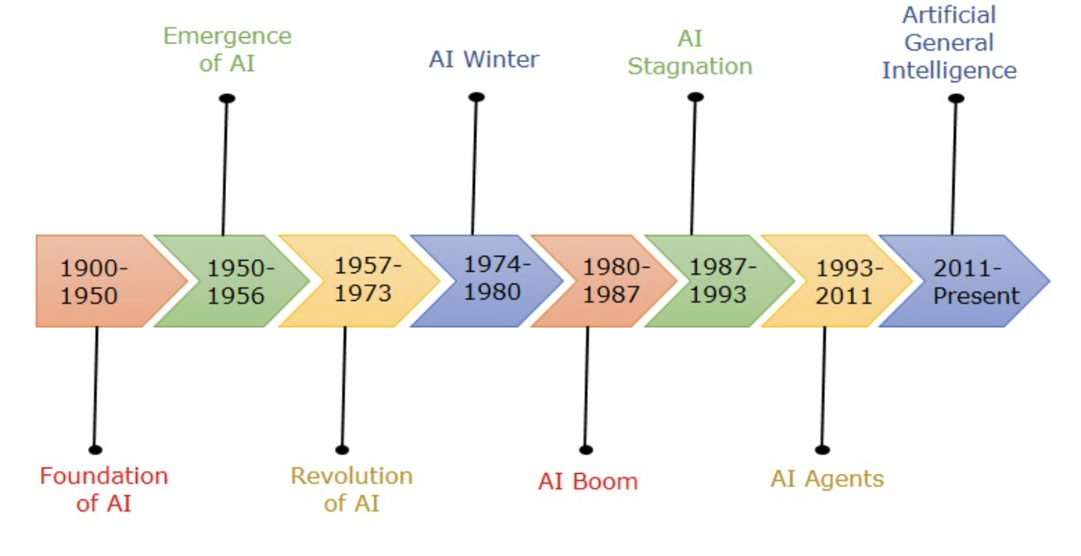
History and Evolution
1940s–1950s: Foundations of AI; early research on intelligent machines.
1950: Alan Turing proposed the Turing Test to evaluate machine intelligence.
1956: Dartmouth Conference coined the term Artificial Intelligence (birth of AI).
1956–1970s: Development of early AI programs for problem-solving, games, and reasoning.
1970s–1980s: AI Winter due to limited computing power and reduced funding.
1980s: Rise of Expert Systems for medical, financial, and industrial applications.
1990s–2010s: Growth of Machine Learning using data-driven approaches.
1997: IBM Deep Blue defeated world chess champion Garry Kasparov.
2012: Deep Learning breakthrough significantly improved image and speech recognition.
2016: AlphaGo defeated Go champion Lee Sedol.
2020s–Present: Rise of Generative AI and Large Language Models (LLMs) for text, images, code, and multimodal applications.

Slide 6
Need for A.I
Efficiency and Automation
  Task Automation: AI can automate repetitive tasks, reducing the need for human intervention. This is particularly useful in manufacturing, customer service, and administrative tasks.
  Process Optimization: AI algorithms can optimize business processes, reducing costs and improving efficiency
Data Analysis:
  Big Data: AI can analyze vast amounts of data quickly and accurately, providing insights that would be impossible for humans to glean in a reasonable timeframe
  Predictive Analytics: AI can predict trends and behaviors by analyzing historical data, helping businesses make informed decisions.
Personalization:
  Customer Experience: AI can provide personalized recommendations and experiences in real time, enhancing customer satisfaction. Examples include recommendation systems used by Netflix and Amazon
  Healthcare: AI can personalize treatment plans based on individual patient data, improving health outcomes.
Innovation and Problem-Solving:
  New Solutions: AI can solve complex problems that were previously unsolvable, leading to innovations in various fields such as medicine, climate science, and engineering
  Research: AI accelerates research and development by analyzing scientific data, generating hypotheses, and even conducting experiments.

Slide 7
Need for A.I
Safety and Security:
  Risk Management: AI systems can detect and respond to security threats faster than humans, enhancing cybersecurity
  Health and Safety: AI-powered monitoring systems can improve safety in industries like construction, mining, and healthcare.
Improved Decision-Making:
  Business Intelligence: AI provides actionable insights and forecasts that aid in strategic decision-making
  Real-Time Responses: AI systems can analyze and respond to data in real time, crucial for applications like stock trading, autonomous driving, and emergency response.
Accessibility:
  Assistive Technologies: AI can help individuals with disabilities by providing tools such as speech recognition, real-time translation, and automated text-to-speech
  Language Translation: AI-powered translation services break down language barriers, making information more accessible globally

Slide 8
Characteristics of A.I
Learning: Learns from data and improves performance over time.
Reasoning: Makes logical decisions based on available information.
Problem Solving: Finds efficient solutions to complex problems.
Knowledge Representation: Stores and organizes information for decision-making.
Perception: Understands inputs such as images, speech, and sensor data (face recognition, self-driving cars).
Natural Language Processing (NLP): Understands and generates human language.
Decision Making: Selects the best action based on analysis.
Adaptability: Adjusts to new data and changing environments.
Automation: Performs tasks with minimal human intervention.
Self-Correction: Learns from mistakes to improve future performance.

Slide 9
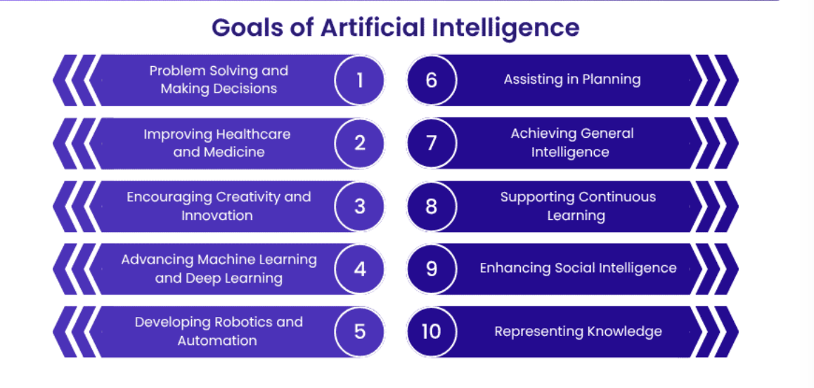
Goals of A.I

Slide 10

Applications of A.I
Healthcare: Disease diagnosis, medical imaging, drug discovery.
Education: Personalized learning, intelligent tutoring systems.
Finance: Fraud detection, credit scoring, algorithmic trading.
Transportation: Self-driving cars, traffic management, route optimization.
Manufacturing: Robotics, quality inspection, predictive maintenance.
Retail & E-commerce: Product recommendations, demand forecasting, chatbots.
Agriculture: Crop monitoring, precision farming, pest detection.
Cybersecurity: Threat detection, malware analysis, intrusion prevention.
Entertainment: Content recommendations, gaming, media generation.
Customer Service: Virtual assistants and AI-powered chatbots.

Slide 11
Agents and Environment
The A.I system consist of an agent and environment, agents acts upon environment.
Agent:
Agent is anything that can be viewed as perceiving its environment through sensors and acting upon that environment through actuators.
Agents runs in the cycle of perceiving, thinking and acting.
The agent receives information from the environment from the sensors and store and process the information in the agent program do the actions by using the effectors

Slide 12
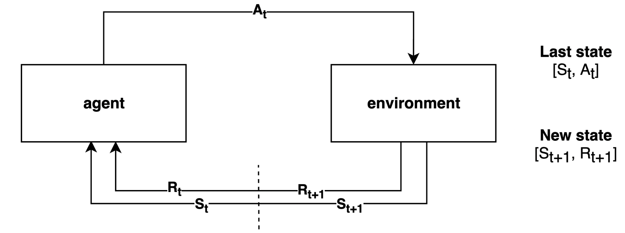

Slide 13
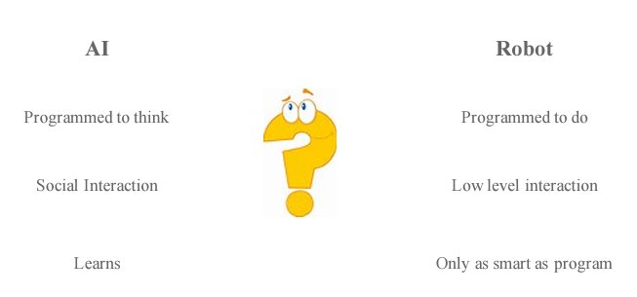
A.I v/s Robot

Slide 14
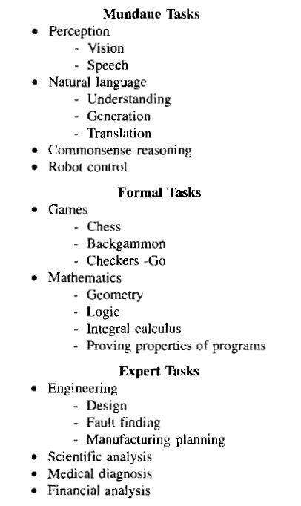
The A.I Problems
This image lists various tasks that AI can perform, categorized into three groups: Mundane Tasks, Formal Tasks, and Expert Tasks. Here's a breakdown of each category:
1. Mundane Tasks:
These are everyday tasks that humans perform naturally but are challenging for AI due to their complexity and the requirement of a vast amount of contextual knowledge.
Perception:
  Vision: The ability to interpret and understand visual information from the world, such as recognizing objects, people, or scenes.
  Speech: Understanding and processing spoken language.
Natural Language:
  Understanding: Comprehending the meaning of words, sentences, and texts.
  Generation: Producing human-like text or speech.
  Translation: Converting text or speech from one language to another.
Commonsense Reasoning:
  The ability to make judgments and decisions based on everyday knowledge that humans take for granted.
Robot Control:
  The ability to manage and direct the actions of a robot, particularly in dynamic environments.

Slide 15
The A.I Problems
2. Formal Tasks:
These are tasks that involve formal rules and structures, often in well-defined environments, and can include strategic or logical reasoning.
Games:
  Chess: A classic AI challenge due to the complexity and need for strategic thinking.
  Backgammon: Another game where AI can be used to predict probabilities and make strategic decisions.
  Checkers: Involves tactical planning and anticipating the opponent's moves.
  Go: A complex board game known for its vast search space and the requirement for pattern recognition.
Mathematics:
  Geometry: Solving problems related to shapes, sizes, and the properties of space.
  Logic: The study of reasoning and the principles of valid inference.
  Integral Calculus: A branch of mathematics dealing with integrals and their properties.
  Proving Properties of Programs: Verifying that software programs function as intended, particularly in terms of correctness and reliability.

Slide 16
The A.I Problems
3. Expert Tasks:
These tasks require specialized knowledge and skills, often involving deep domain expertise.
Engineering:
  Design: Creating plans or specifications for constructing objects, systems, or processes.
  Fault Finding: Identifying and diagnosing issues or defects in systems or products.
  Manufacturing Planning: Strategizing and organizing the production process to optimize efficiency and output.
Scientific Analysis:
  Using AI to process and interpret scientific data, conduct experiments, or simulate complex systems.
Medical Diagnosis:
  AI assists in diagnosing diseases or medical conditions by analyzing patient data, symptoms, and medical history.
Financial Analysis:
  AI is used to analyze financial markets, assess risks, and make investment decisions based on vast amounts of data.

Slide 17
The A.I problems: Conclusion
This categorization highlights the broad range of applications for AI, from routine tasks that humans do naturally (but are complex for machines) to tasks requiring formal reasoning and specialized expert knowledge. The list provides a snapshot of the diverse challenges AI tackles across different domains, reflecting the interdisciplinary nature of the field.

Slide 18

The A.I Problems
Problems to answer
What are the underlying assumptions about intelligence?
What kinds of techniques will be useful for solving AI problems?
At what level of detail, if at all, are we trying to model Human Intelligence?
How will we know when we have succeeded in building an intelligent program?

Slide 19
What is an A.I Technique?
An AI technique is a method that exploits knowledge that should be represented in such a way that:
    The knowledge captures generalizations. it is not necessary to represent separately each individual situation, Instead, situations that share important properties are grouped together. If not having this property, inordinate amounts of memory and updating will be required, then it will be called “data” and not knowledge.
    It can be understood by people who must provide it.[ taking values automatically through several instruments] must provide knowledge in terms they understand.
    It can easily be modified to correct errors and to reflect changes in the world.
    It can be used in many situations even if its not totally accurate or complete.
    It can be used to help overcome its own sheer bulk by helping to narrow the range of possibilities that must usually be considered.

Slide 20
Machine Learning
Machine Learning (ML) is a branch of Artificial Intelligence (AI) that enables computers to learn from data and improve their performance without being explicitly programmed. ML algorithms identify patterns in data and use them to make predictions or decisions.

Slide 21
Why Machine Learning is Important?
Automates Decision-Making – Makes predictions and decisions without explicit programming.
Handles Large Volumes of Data – Analyzes massive datasets quickly and efficiently.
Improves Accuracy – Learns from data and becomes more accurate over time.
Identifies Hidden Patterns – Discovers trends and relationships that humans may miss.
Enables Personalization – Powers recommendation systems for shopping, entertainment, and social media.
Supports Real-Time Predictions – Detects fraud, predicts demand, and monitors systems instantly.
Drives Innovation – Forms the foundation of AI applications such as self-driving cars, healthcare, and robotics.
Reduces Time and Cost – Automates repetitive tasks, improving productivity and efficiency.

Slide 22
Applications of ML
Email spam filtering
Recommendation systems
Fraud detection
Medical diagnosis
Image and speech recognition

Slide 23
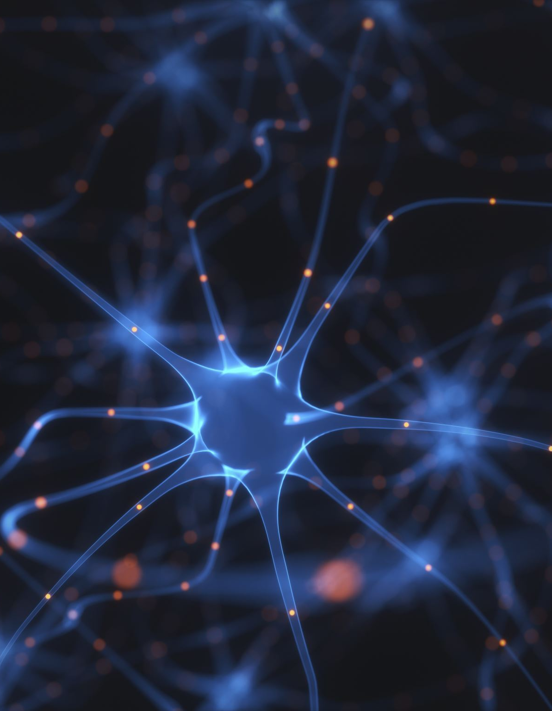
Neural Networks
A Neural Network is a machine learning model inspired by the structure and functioning of the human brain. It consists of interconnected processing units called artificial neurons, which work together to learn patterns from data and make predictions or decisions.
A Neural Network is a computational model made up of interconnected neurons that learns from data to recognize patterns, classify information, and make predictions.

Slide 24
Main Components
1. Input Layer
First layer of the neural network.
Receives the input data (images, text, numbers, etc.).
Passes the data to the hidden layer(s).
2. Hidden Layer(s)
One or more intermediate layers between the input and output.
Extracts features and learns patterns from the input data.
Performs computations using weights, biases, and activation functions.
3. Output Layer
Final layer of the network.
Produces the prediction or classification result.
Number of neurons depends on the task (e.g., one neuron for binary classification, multiple neurons for multi-class classification).

Slide 25
Main Components
4. Neurons (Nodes)
Basic processing units of the network.
Receive inputs, perform calculations, and pass the output to the next layer.
5. Weights
Numerical values that determine the importance of each input.
Updated during training to improve the model's performance.
6. Bias
An additional parameter added to the weighted input.
Helps the network learn more effectively by shifting the activation function.
7. Activation Function
Determines whether a neuron should be activated.
Introduces non-linearity, enabling the network to learn complex patterns.
Common activation functions: ReLU, Sigmoid, Tanh, Softmax.

Slide 26
How It Works
Each neuron performs calculations using weights, biases, and an activation function.
Information flows through one or more hidden layers.
The output is generated.
During training, the network adjusts its weights using backpropagation to reduce errors and improve accuracy.

Slide 27
Advantages of Neural Network
Learns Complex Patterns – Can identify intricate relationships in large and complex datasets.
High Accuracy – Provides excellent performance for tasks such as image recognition, speech recognition, and classification.
Automatic Feature Learning – Learns important features directly from raw data, reducing the need for manual feature engineering.
Handles Non-Linear Problems – Models complex, non-linear relationships that traditional algorithms may struggle with.
Adaptable and Scalable – Improves as more training data becomes available and scales to large datasets.
Robust to Noisy Data – Can still perform well even when the input data contains some errors or noise.
Supports Multiple Data Types – Works with images, text, audio, video, and numerical data.
Wide Range of Applications – Used in healthcare, finance, autonomous vehicles, cybersecurity, Natural Language Processing (NLP), and recommendation systems.

Slide 28

Applications of Neural Network
Image and face recognition
Speech recognition
Natural Language Processing (ChatGPT, translation)
Medical diagnosis
Fraud detection
Autonomous vehicles
Recommendation systems

Slide 29
Natural Language Processing (NLP)
Natural Language Processing (NLP) is a branch of Artificial Intelligence (AI) that enables computers to understand, interpret, process, and generate human language in both text and speech forms.

Slide 30
How NLP Works?
Text Input – Receive text or speech from the user.
Preprocessing – Tokenization, stop-word removal, stemming/lemmatization.
Feature Extraction – Convert text into numerical representations.
Model Processing – Use Machine Learning or Deep Learning models.
Output Generation – Produce predictions, translations, summaries, or responses.

Slide 31
Applications of NLP
Chatbots and Virtual Assistants (e.g., ChatGPT, Siri, Alexa)
Language Translation
Email Spam Detection
Sentiment Analysis
Voice Recognition
Search Engines
Text Summarization
Grammar and Spell Checking

Slide 32
NLP Tasks
1. Tokenization
Splits text into smaller units called tokens (words or sentences).
Example:
"I love AI" → ["I", "love", "AI"]
2. Stop Word Removal
Removes common words that carry little meaning.
Example:
"The cat is on the mat" → "cat mat"

Slide 33
NLP Tasks
3. Stemming
Reduces a word to its root form by removing prefixes or suffixes.
The resulting word may not be a valid dictionary word.
Example:
  Playing → Play
  Running → Run
4.Lemmatization
Converts a word to its base (dictionary) form, called the lemma.
Produces meaningful words using vocabulary and grammar rules.
Example:
  Running → Run
  Better → Good
  Studies → Study

Slide 34
NLP Tasks
5. Part-of-Speech (POS) Tagging
Identifies the grammatical role of each word.
Example:
"The cat runs" → The (Determiner), cat (Noun), runs (Verb)
6. Named Entity Recognition (NER)
Identifies named entities such as people, places, organizations, and dates.
Example:
"Sundar Pichai works at Google."
  Sundar Pichai → Person
  Google → Organization

Slide 35
NLP Tasks
7. Parsing
Analyzes the grammatical structure of a sentence.
Helps understand the relationship between words.
8. Sentiment Analysis
Determines whether text expresses a positive, negative, or neutral sentiment.
Example:
"The movie was amazing!" → Positive

Slide 36
NLP Tasks
9. Text Classification
Assigns text to predefined categories.
Examples: Spam detection, news classification, topic categorization
10. Text Summarization
Generates a concise summary while preserving key information.

